Slide 1
Database Concepts

Slide 2
Topics Covered
Database Design
Relational Model Concepts
DBMS Keys
DBMS Functional Dependency
Data Integrity & integrity rules
ER Diagram
Data Modelling
Codd’s 12 rules for a Relational Database

Slide 3
Three level of data modeling
Conceptual: This Data Model defines WHAT the system contains. The purpose is to organize, scope and define business concepts and rules.
Logical: Defines HOW the system should be implemented regardless of the DBMS. The purpose is to developed technical map of rules and data structures.
Physical: This Data Model describes HOW the system will be implemented using a specific DBMS system. The purpose is actual implementation of the database.

Slide 4
Conceptual data model
A conceptual data model identifies the highest-level relationships between the different entities. Features of conceptual data model include:
Includes the important entities and the relationships among them.
No attribute is specified.
No primary key is specified.

Slide 5
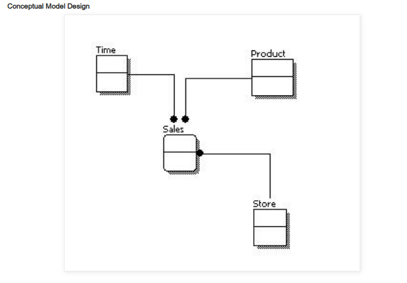
Data modelling

Slide 6
Logical data model
A logical data model describes the data in as much detail as possible, without regard to how they will be physical implemented in the database. Features of a logical data model include:
Includes all entities and relationships among them.
All attributes for each entity are specified.
The primary key for each entity is specified.
Foreign keys (keys identifying the relationship between different entities) are specified.
Normalization occurs at this level.

Slide 7
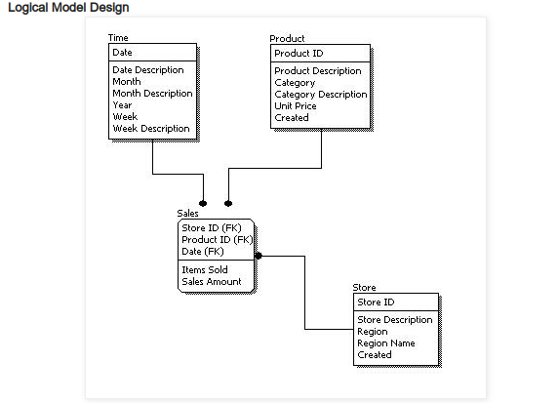
Data modelling

Slide 8
Physical data model
Physical data model represents how the model will be built in the database. A physical database model shows all table structures, including column name, column data type, column constraints, primary key, foreign key, and relationships between tables. Features of a physical data model include:
Specification all tables and columns.
Foreign keys are used to identify relationships between tables.
Physical considerations may cause the physical data model to be quite different from the logical data model.
Physical data model will be different for different RDBMS. For example, data type for a column may be different between Oracle, DB2 etc.

Slide 9
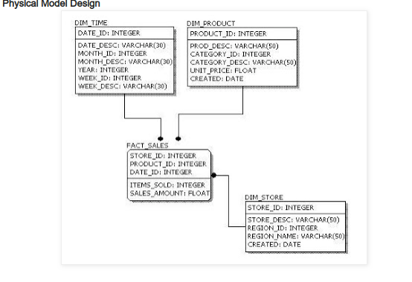
Data modelling

Slide 10
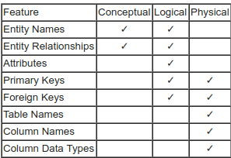
Data modelling

